Slide 1
Continuous Integration & Release process for Tizen Tools

Slide 2
Agenda
Development & Testing
Release & Deployment
Future plan

Slide 3
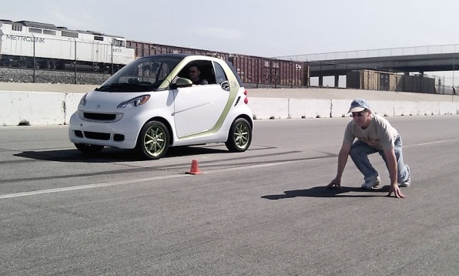
Principles
Small commits
Auto build
Auto testing
Every commit should be built
Build fast
Staging server
Auto deployment
Everybody see results

Slide 4

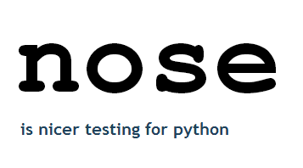


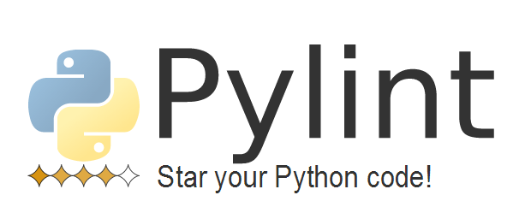




Notes:
OBS: show web page, tar+spec => rpm/deb
Gerrit: events route to jenkins
KVM: 15+ different linux distributions
Ansible: one command to setup a service

Slide 5
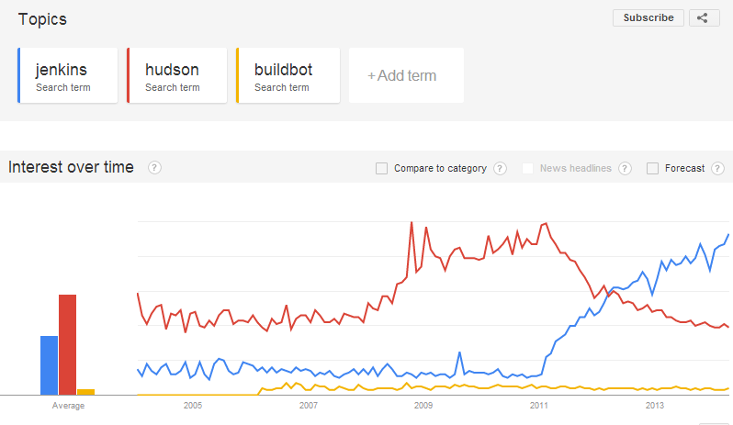
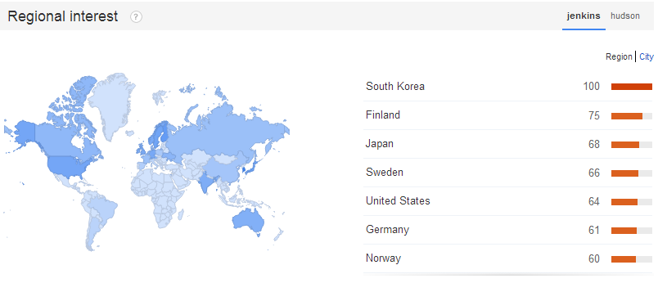
Jenkins @ Google Trends

Slide 6
Development process

Slide 7

Branching model
Devel
Release-0.1
Hostfix: release-0.1.1
Master
Refs: http://nvie.com/posts/a-successful-git-branching-model/

Slide 8
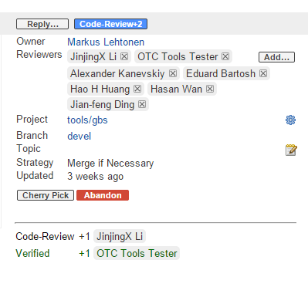

1: Patch verification
Submit patch to Gerrit and have peer review

Slide 9
2. Package building
Automatically building package in OBS corresponding projects
Launch KVM to install it inside and run unit tests
At any time, a patch is in review or merged. We can always get its rpm/deb package
Gerrit branch | OBS project
Refs/changes/1234/1 | Home:tester-<project>-1234.1
Devel | Tools:Devel
Release* | Tools:Pre-release
Master | Tools
Notes:
Refs/changes/xxx means patches is in reviewing

Slide 10
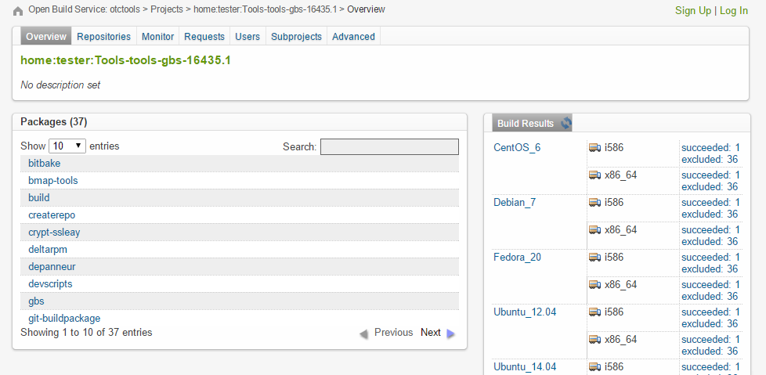
2.Package building

Slide 11
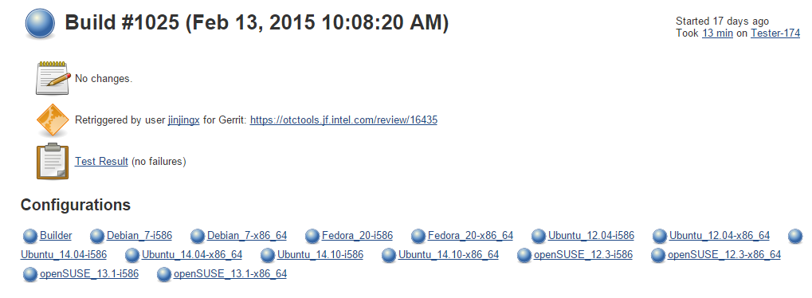
3: Unit testing
Run unit tests for every patch;
Give verity +1 if all tests are passed otherwise -1

Slide 12
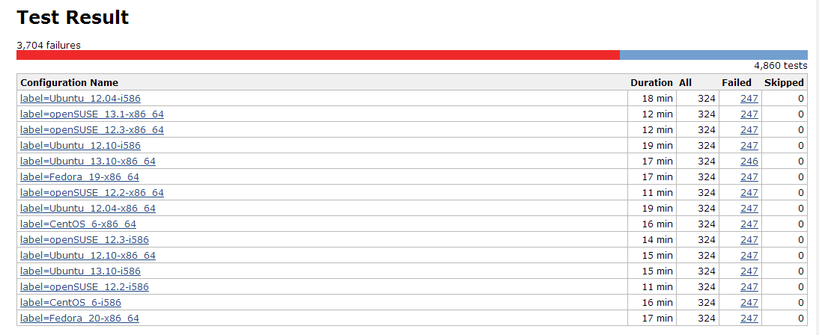
Bad things shows up early

Slide 13
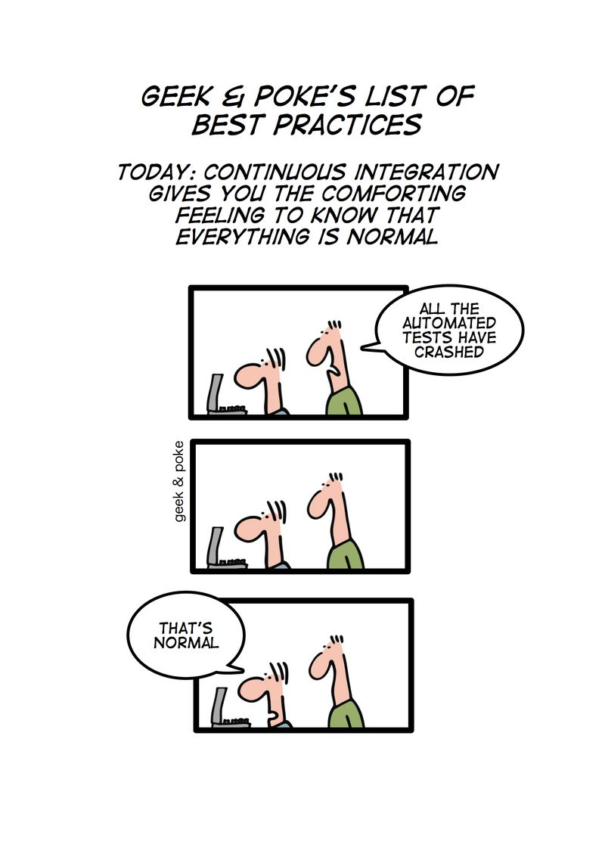

Slide 14
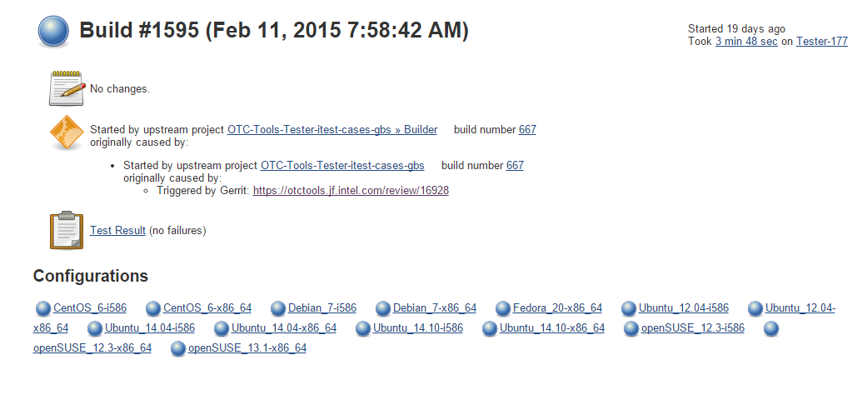
4. Functional testing
Functional testing takes more time
For every patch run basic functional tests
For every day, run all test cases

Slide 15
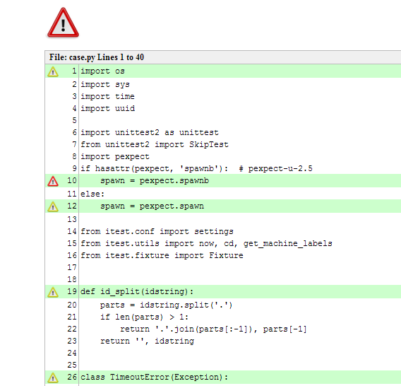
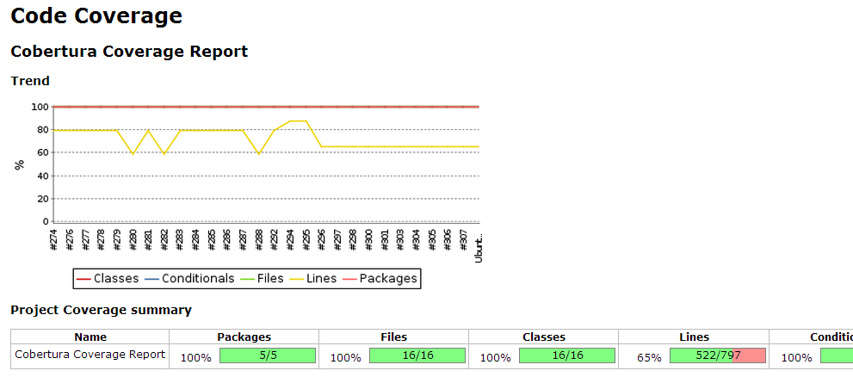
5.Code checks

Slide 16
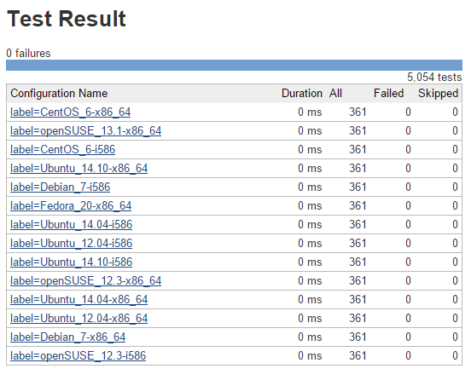
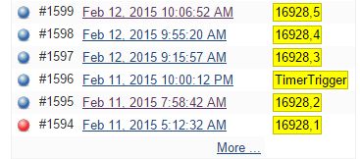
6. Daily testing
It takes hours
Notes:
Trigger by change or time scheduler
Cases numbers
Run time: 3-4 hours for gbs

Slide 17
Development and release flow
Jenkins
Git branch
OBS
download repo
testing
pre-review
testing
pass
peer
review
accept
‘Devel’ branch
Tools:Devel
download.otctools.jf.intel.com/Tools:/Devel/
Functional testing
patch
failed
reject
branch
hot fix
peer
review
accept
‘release-*’ branch
Tools:pre-release
download.tizen.org/tools/pre-release/
Full testing
merge
Deploy request
‘master’ branch
Tools
download.tizen.org/tools/archive/
download.tizen.org/tools/latest-release/
Sanity testing
Release announce
handled by Jenkins automatically

Slide 18
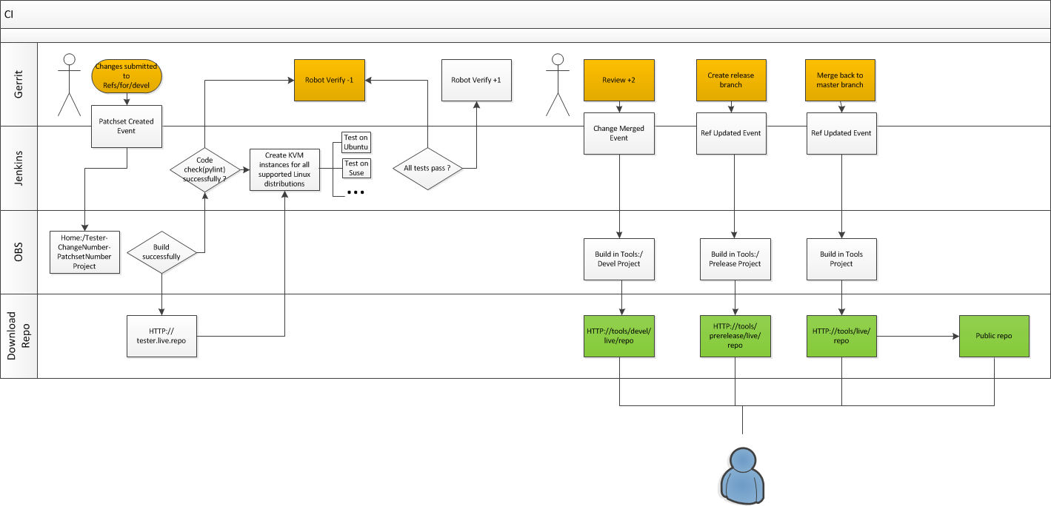

Slide 19
Release process
Release docs
https://otctools.jf.intel.com/

Slide 20
1.Create release branch
Increase version number in release branch
Automatic package building (Tools:Pre-release)
Verification in local (pre-release testing)
Review testing report
If any bug found in verification we will fix them in release branch and run tests again.

Slide 21
2.Internal release
Update to master branch
Automatic package building (Tools)
Make git tag of this version
Using release job(Jenkins) to publish repo to internal download server
Verification on staging server (pre-deployment testing)
Review testing report
If any bugs found in this phase, we will fix them in release branch as well. And go back to the last step.
Notes:
http://download.otctools.jf.intel.com/staging/tools/archive/
http://download.tizen.org/tools/archive/
Apt-get install
Zypper install
Yum install

Slide 22
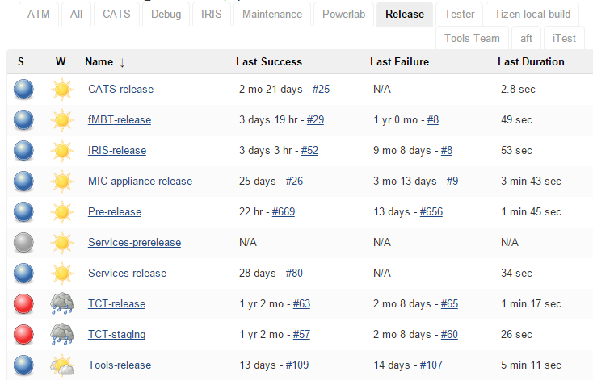
Release jobs(Jenkins)

Slide 23
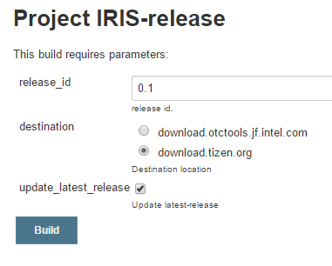
A release job

Slide 24
3.Release
Using release job(Jenkins) to publish repo to tizen.org download server
Sanity check
If we found serious problem after official release. We have to increase version number for hotfix and do the whole release process again..

Slide 25
4.Deployment
Create a deployment ticket in JIRA
Review the deployment instruction
Deploy by Ansible (if available)
Verification on production server
Notes:
JJ/iris
gbs

Slide 26
5.Announcement
Send an announcement to mailing lists
Sync code to github/01org

Slide 27
Future plan
Using vagrant to replace current shell scripts
Make a web UI for users to control his/her jobs

Slide 28
Thanks !
Q & A

